Slide 1
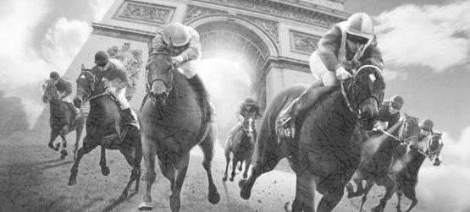
QUALITY CONTROL OF GROUP/GRADED RACES
OPEN FORUM
BRIAN KAVANAGH, VICE CHAIRMAN, IFHA

Slide 2
Quality Control of Group / Graded Races
Brian Kavanagh
Vice Chairman, IFHA

Slide 3
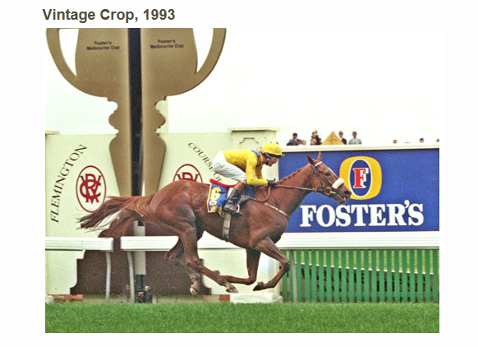

Slide 4
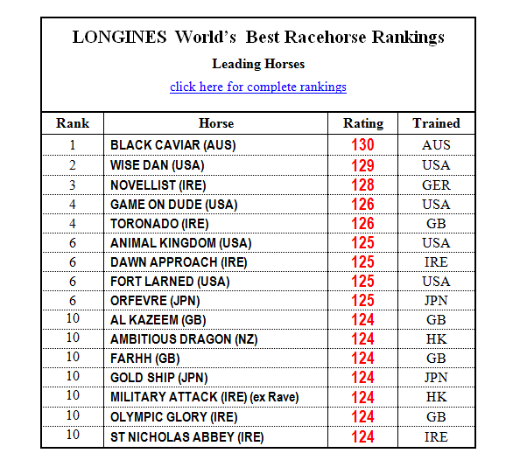

Slide 5
IFHA Basic Mission
“The organisation of competitions to select the best horses in order to improve the quality of breeding”
IFHA website

Slide 6
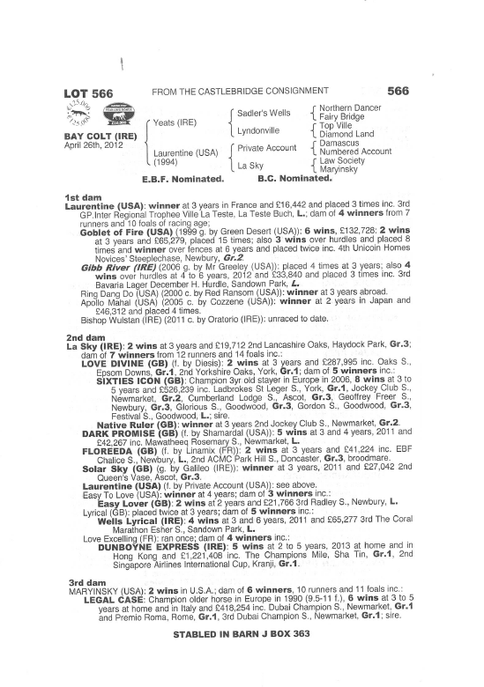

Slide 7
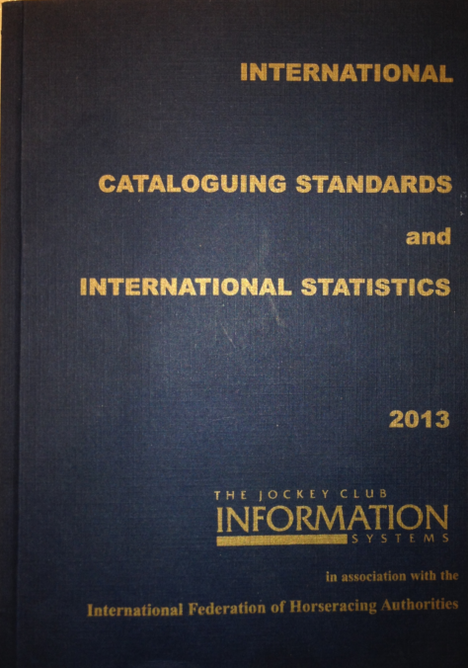

Slide 8
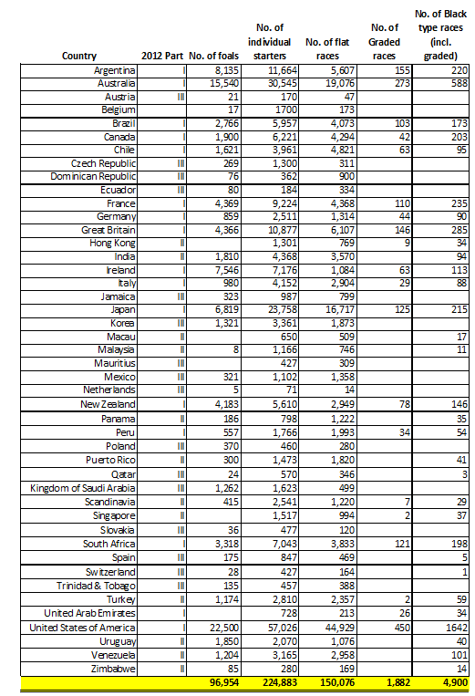
Cataloguing Standards Information 2012

Slide 9
International Cataloguing Standards
PART I:
First 3 in Group / Listed Races receive Black Type
Winners receive Upper Case Black Type
Placed receive Lower Case Black Type
Group Designator Shown after Black Type
PART II:
First 3 receive Black Type
No Group Designator Shown
PART III:
No Black Type attached
Group / Grades only recognised in that country
PART IV:
National Hunt
Races listed in Italic form
Regional preference whether black type used

Slide 10
Authorities recognised by IRPAC for Grading of Races in Part I
European Pattern Race Committee
TOBA American Grades Stakes Committee
Jockey Club of Canada
Asian Racing Federation*
OSAF*
* These organisations review the lists submitted by their members

Slide 11
Criteria for Quality Control
Ratings of first four horses
Shape of overall pattern
Field sizes
Prize money
Overall quality of Field
Other black type races in country

Slide 12
Number of Graded / Black Type Races 2012

Slide 13
Trends in Foal Crop and Flat Races 1982 - 2012

Slide 14
Number of Group / Graded Races Worldwide

Slide 15
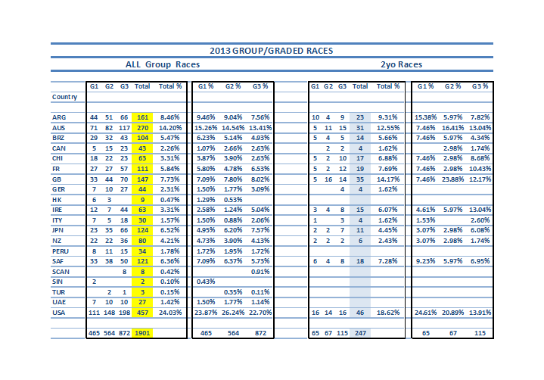
2013 Group / Graded Races

Slide 16
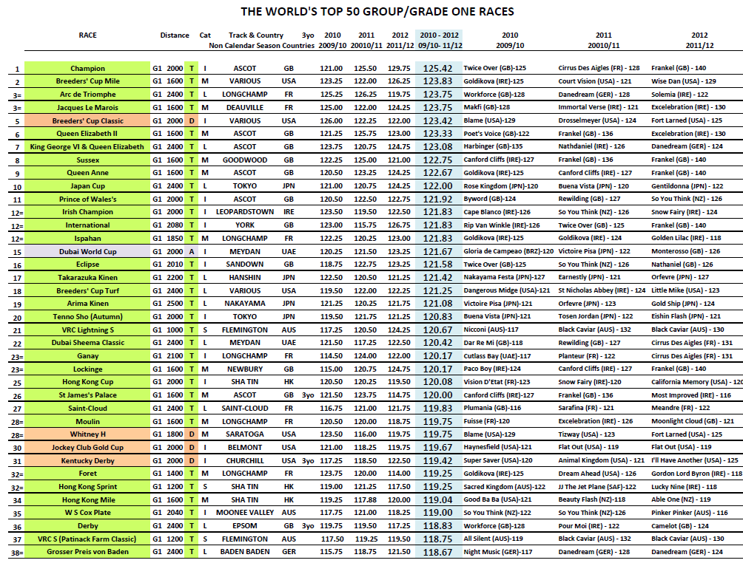
World’s Top Races 2012

Slide 17
Thank You

